Slide 1

Credit Card Approval
User Manual
Author: Ahmed Sayyed
Notes:
Preworks course home assignments

Slide 2
Table of Contents
Acknowledgments
About Me
My Journey with Clevered
About App
How to use the app
Contact Details

Slide 3
Acknowledgements
I extend my heartfelt gratitude to Clevered and Avishek sir for supporting me throughout this journey. This was an incredible experience for me, one truly I can never forget. I also would like to thank my parents and Dr. Ken for giving me this opportunity to enhance and showcase my coding skills.

Slide 4

About Me..
My name is Ahmed Sayyed, and I was born on the 26th of July in Mumbai, India. I’m 14 years old, and I have a strong passion for playing the keyboard and coding. These hobbies keep me busy in my free time and allow me to explore my creative side. I’ve always dreamt of becoming a Robotic Engineer, and I’m working hard toward making that dream a reality someday.

Slide 5
About My Internship Journey with Clevered..
Over the past 3 months, my internship journey with Clevered has been amazing. I have been with Clevered since 2022 and I have never faced a problem. My mentors were always supportive and Avishek sir had helped me a lot throughout this journey.

Slide 6
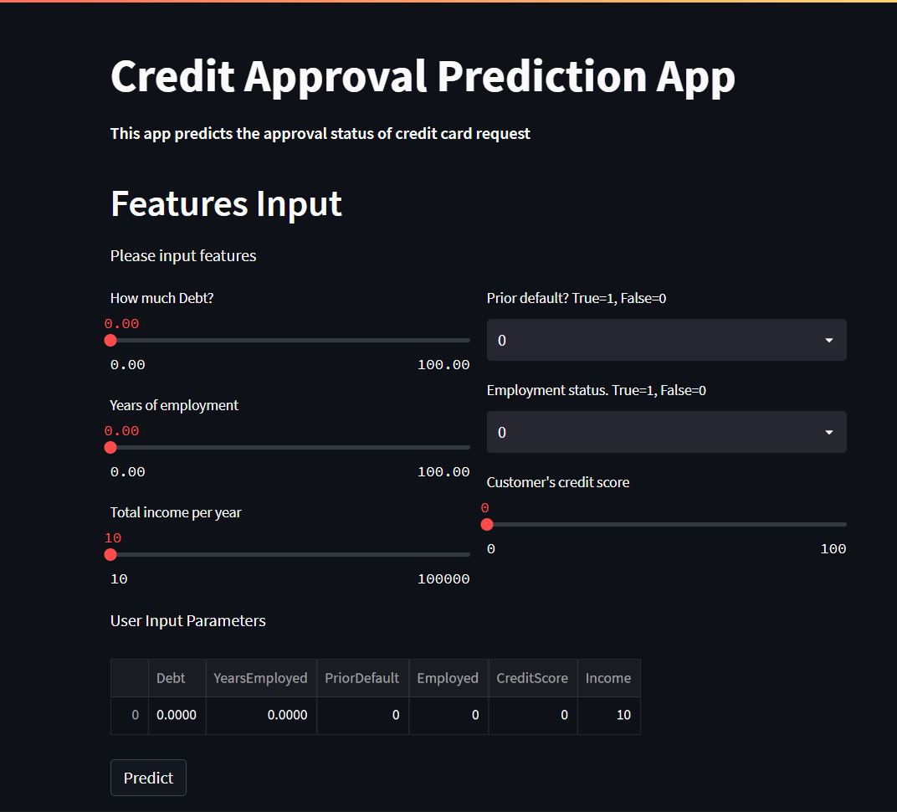
About App..
This is an app aiming to streamline credit card applications for bankers and to ease up their work. The app primarily functions by taking some parameters from the banker regarding the customer. The app has a highly intuitive UI made with Streamlit which allows everyone to use the app without any hurdles. The app runs on a model created using various different libraries through Jupyter Notebook.

Slide 7
How do I use the App?

Slide 8
App User Interface Screen 1

Slide 9
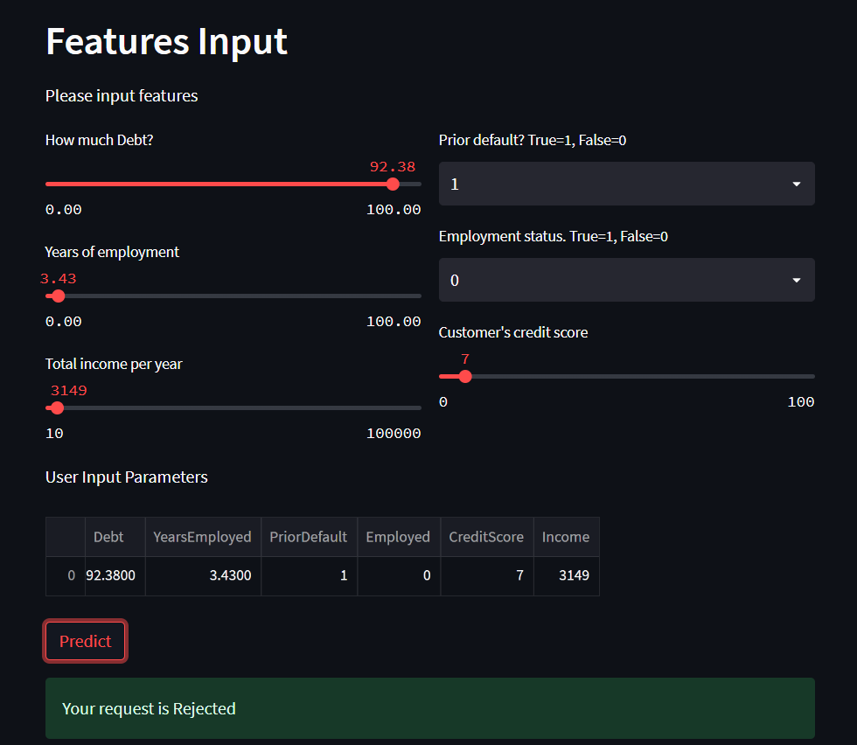
App User Interface Screen 2

Slide 10
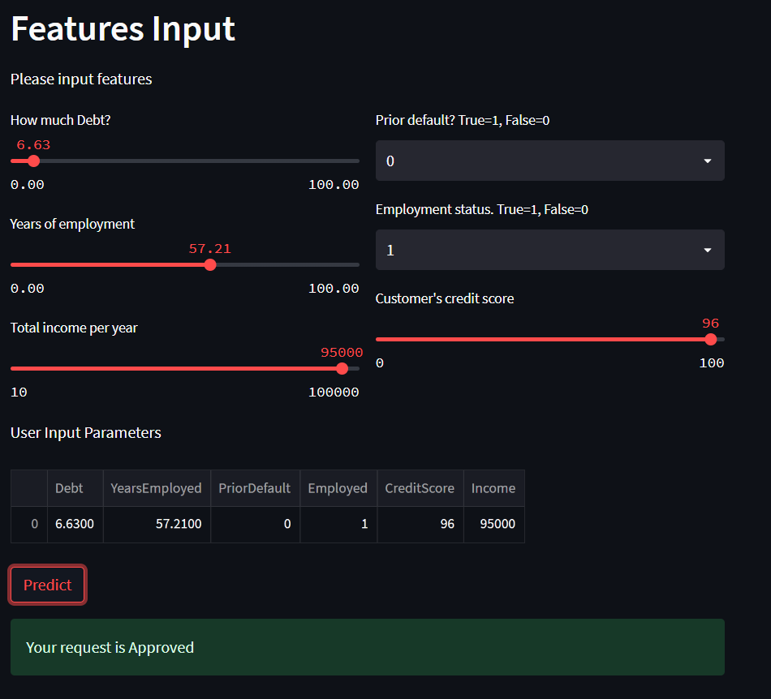
App User Interface Screen 3

Slide 11
Contact Person
Please reach out to Ahmed Sayyed at ahmedsayyed2607@gmail.com for any questions/ concerns/ suggestions on the App

Slide 12
Thank you!

